Slide 1

Alfred’s Retirement
Plan
Aleks Popovic and Annika Lindgren

Slide 2
Introduction and Assumptions
Alfred is currently 37 and would like to retire by the age 65
His current amount of savings for retirement is $43,482.62
He makes $95,000 a year with a 2% salary increase annually
He makes annual contributions of 2.5% of his salary, and employer contributes 5%
He expects to need 80,000 a year post retirement with taxes of 15% from each withdrawal
He also expects an annual rate of return of 4% on amount in account
Maximum contribution is 22,500 a year

Slide 3
Problem
Create a model which allows Alfred to analyze and make decisions based on all his possible retirement ages, and additional contributions.
As well as provide him with considerations for his decision.

Slide 4
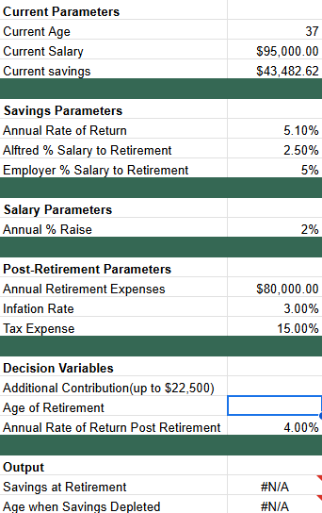
Parameters
Our Additional Contribution and Age of Retirement remain blank to allow us to change our data to get results for what we want
Our savings at retirement output gives us the level of savings at a given age of retirement which we change through our decision variable. We did this with the VLOOKUP function
Our age when savings depleted gives us the age at which Alfred would run out of savings at a given age and given additional contribution., We did this with an INDEX-MATCH function.

Slide 5
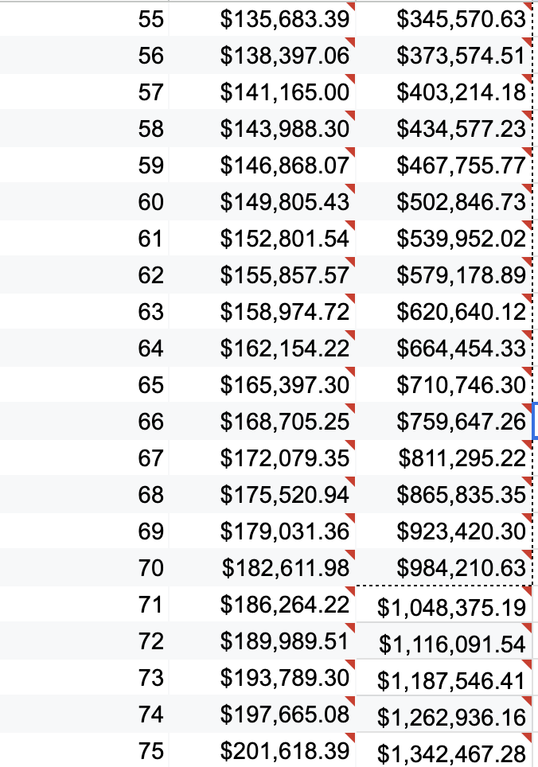
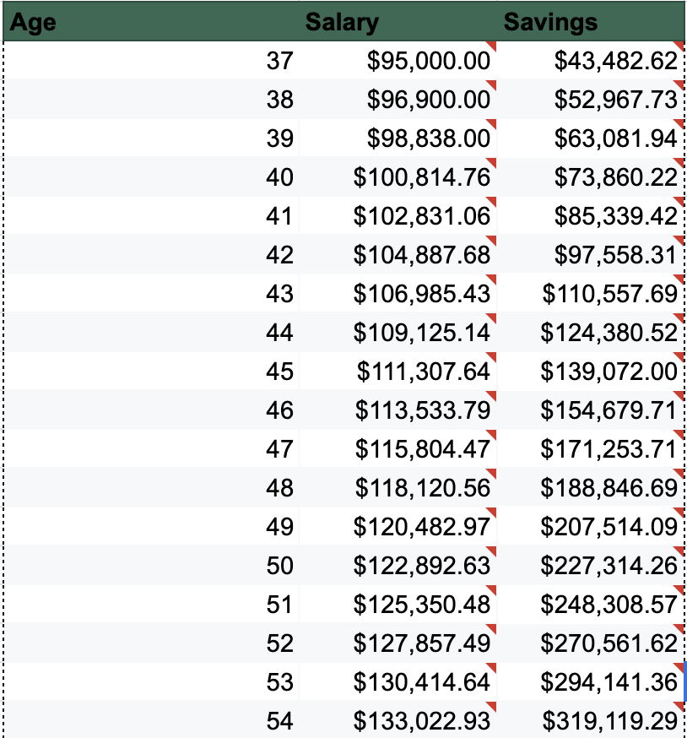
Retirement Planning
Notes:
This table shows the age Alfred is, and the correlation to salary and his retirement savings as he gets older.
Savings change based on level of additional contribution set in our parameters

Slide 6
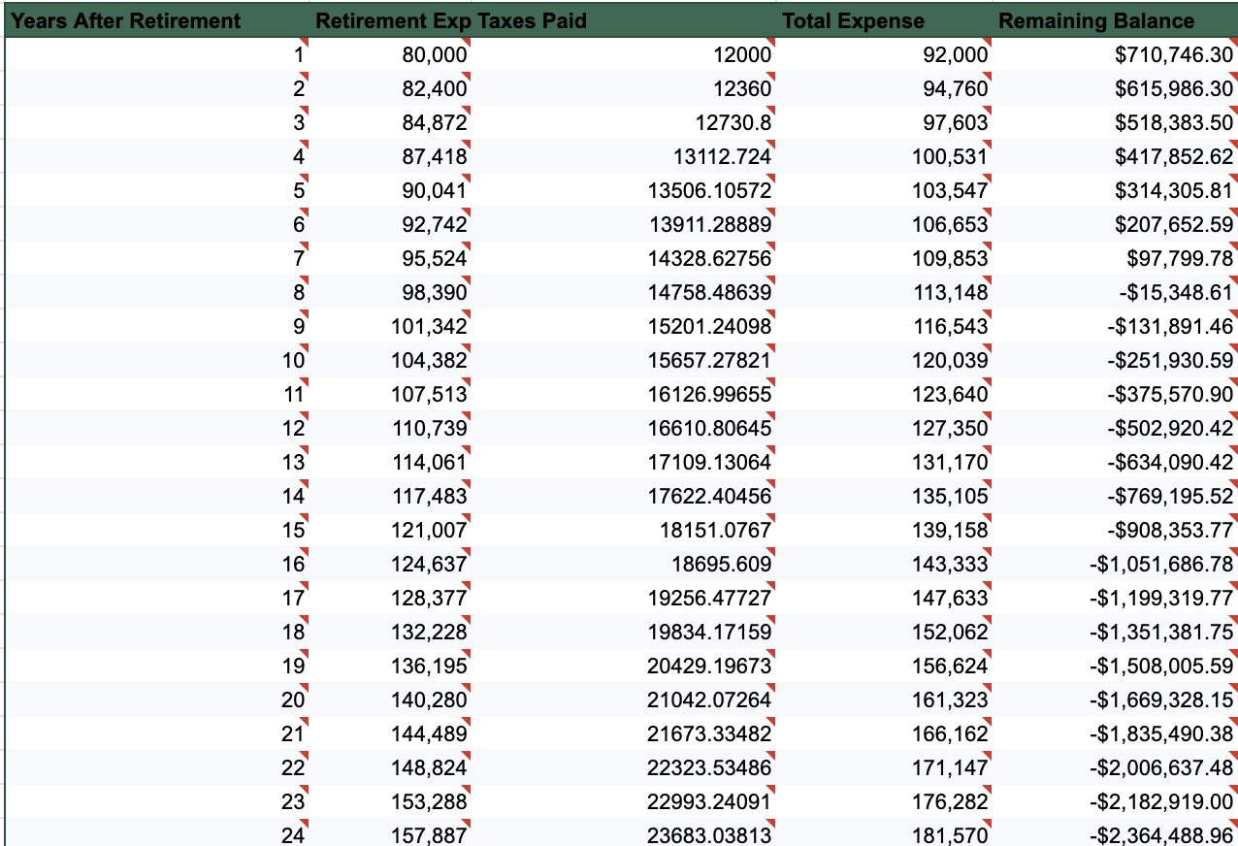
Post
Retirement
Notes:
This tables shows how many years after Alfred’s expected retirement , the expected expenses plus tax expense decreasing the total amount of his savings.

Slide 7
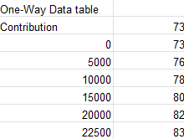
Alfred at age 65
Alfred said he would ideally retire at 65
The chart on the left shows Alfred’s options if he wishes to retire at 65
In the case he contributes an additional $0 he would run out of money at age 73
In the case he contributes an additional $22500 he would run out of money at 83

Slide 8
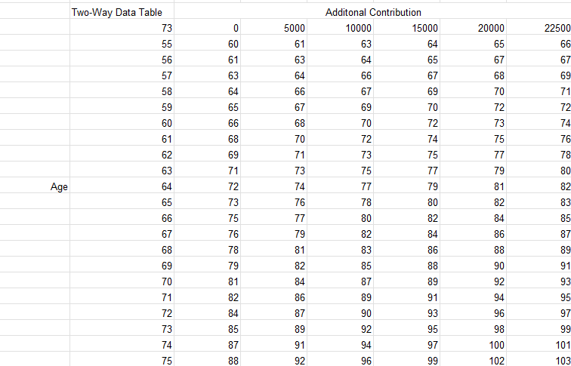
Alfred’s Options
This two way data table shows us all of Alfred’s options for retiring between the ages of 55 and 75
All of which are at different levels of voluntary contributions

Slide 9
Results and Recommendations
At age 65 with no additional contribution Alfred would run out of money at age 73. With maximum contributions it would be at age 83.
It is fundamentally up to Alfred to use our model to weigh all his options and find the age of retirement and level of contribution which will maximize his happiness and income.
Some considerations Alfred should take into consideration are: if he wants money left over to leave to somebody, economic conditions, potentially raising his additional contributions as his salary increases,etc.
Alfred could choose live more modestly pre or post-retirement

